Slide 1
Reengineering Project: Gorillas
Team Name: Team Dank
Team Members: Steven Hartnett, Kyle Hoffhein, Kyle Kwasniewski, Jonah Tollefson

Slide 2
Porting Process
Tools
Microsoft Word, Microsoft Excel, Microsoft Project, NetBeansIDE, DOSBox
Methods
Test-Driven Development, Structured Analysis

Slide 3
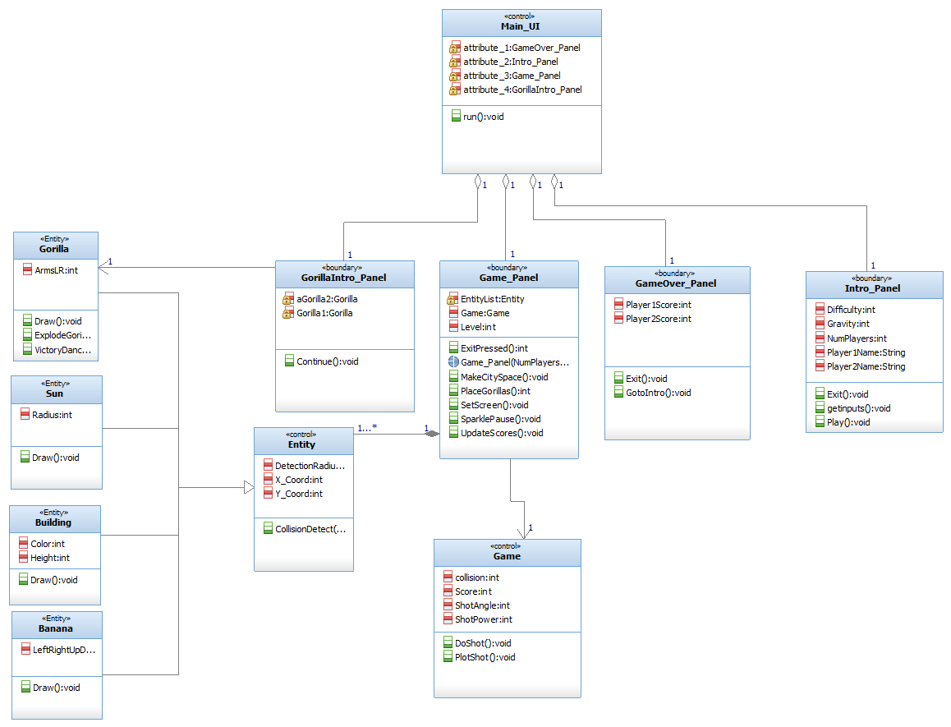
Old Class Diagram

Slide 4
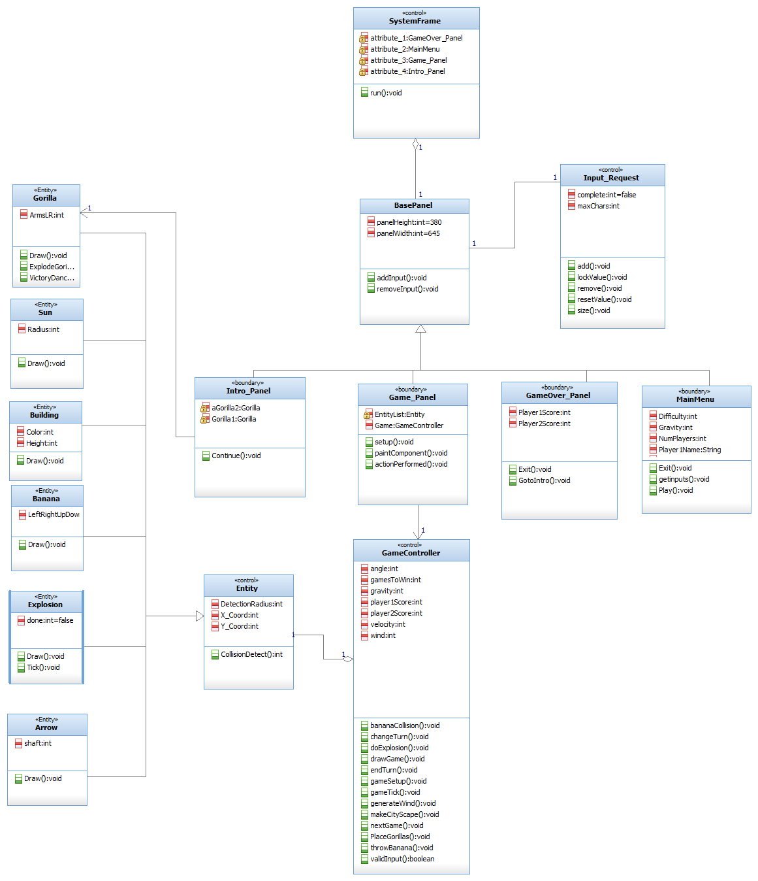
New Class Diagram

Slide 5
Demonstration of the Program
DEMO

Slide 6
System Defects/Missing items
Missing Items
No sound.
Known Defects
If tested often enough a building can be created to small to the right of the screen. (1 in 20,000 chance)

Slide 7
Testing Strategy
Use of JUnit testing.
Equivalence class partitioning.
Robust boundary testing on inputting into UI
Normal boundary testing on algorithms in code.

Slide 8
Issues during the Porting Process
Capturing a solid understanding or certain algorithms used by the original source code.
Planning appropriate test that cover the majority of our program.
Deviation from the plan due to issues with the planned structure.
Source code language understanding.
Source code wasn't that same as given testable game.
Difficult to test some methods due to the output type of those methods.

Slide 9
Lessons
Difficulties of using Test-Driven Development.
Communicating task through individuals of different coding skill levels and styles.
The difficulties of changing from functionally transformed code into a structured code.

Slide 10
Questions
?

